Slide 1


Slide 2

Under the guidance of Dr. Prakash G.L Assistant Professor Department Of Computer Science
IBM Project
PRESENTATION
Analyzing Vocal Patterns to Determine Emotion
Submitted By:
Name | Sap-ID | Roll-No
Kshitiz | 500069504 | R970218030
Kartikey Semwal | 500070071 | R142218074
Aryaman Singh | 500068041 | R100218007
Animesh Anand | 500067250 | R970218005

Slide 3
OVERVIEW
Project Title
Introduction
Objectives
Methodology
Diagrams
Algorithm’s
Code
Result
Reference's

Slide 4

Analyzing Vocal Patterns to Determine Emotion

Slide 5
Introduction
Speech or audio signal is one of the most sentimental and natural way for communication among human beings.
Humans use different speech tones to express their emotions. Therefore, the emotion categories fall into the different levels Like, Happy, Normal, Sad, Angry, and Disgusting.
The idea behind developing this project is to build a machine learning model that could detect emotions from the speech or perhaps conversations.
The recognizing of emotional conditions in speech signals are very challengeable task due to defining the boundaries and distinguishing between them and measuring them in a meaningful way.
The Mel Frequency Cepstral Coefficients (MFCC) technique is the one of the most popular spectral based parameters used in recognition system approach.

Slide 6
The MFCC has advantage over servals techniques which is less complexity in implementation algorithm for feature extraction.
The MFCC feature extraction technique basically includes several filters start from windowing filter, Discrete Fourier Transform filter, log filter for the magnitude, etc.
The Convolutional Neural Network (CNN), is the one of few successful neural network architecture particularly for the model architecture that is used in this project.

Slide 7
Problem Statement
Very few robust technique for feature extraction and acoustics data classification has been proposed till date on employed data set.

Slide 8
Objective
Extract Audio features using MFCC.
Using extracted features to train and test model.
Implementing trained model for emotion prediction on New data.

Slide 9
Methodology
Step-1: Load Pre-processed(SAVEE & RAVDESS) Data set.
Step-2: Data framing(Data_path.csv) on data set for a better understanding of present data.
Step-3: MFCC feature Extraction on Data set for audio features.
Step-4: Include extracted features in the data frame and replace Nan values with zero(0).
Step-5: Splitting features for Training and Testing data.
Step-6: Normalization on Training and Tested data for better understanding of data.
Step-7: Training Model using CNN 1D model.
Step-8: Test Model for testing data.

Slide 10
Step-9: Plot Model for visualization.
Step-10: Save model to disk and print model accuracy.
Step-11: Load Predictions and apply label's on them.
Step-12: Compare actual and predicted values.
Step-13: Save Prediction values on disk (Predictions.csv).
Step-14: Measure Accuracy of model in every term.
Step-15: Take new audio data for prediction.
Step-16: Load model in code.
Step-17: Prepare data for prediction.
Step-18: Apply and show predicted Emotion.

Slide 11
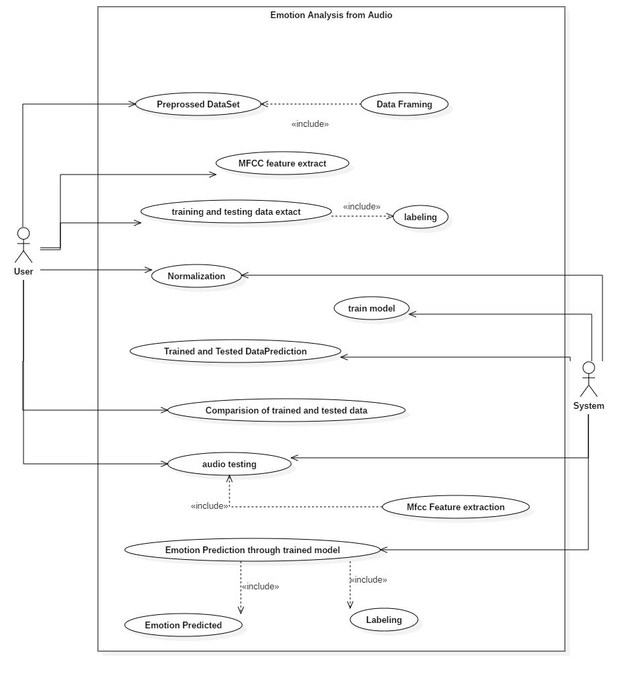
Diagrams
Use Case

Slide 12
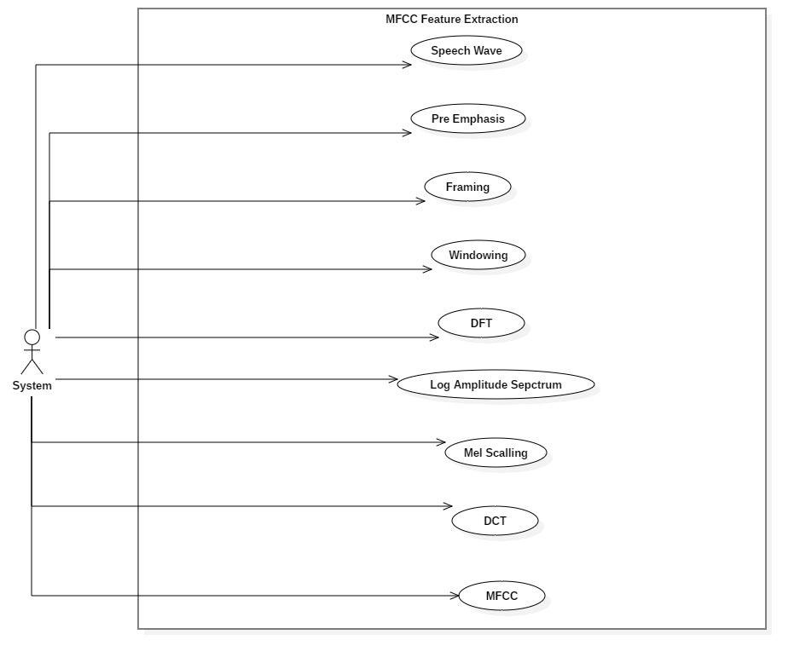
Use Case MFCC

Slide 13
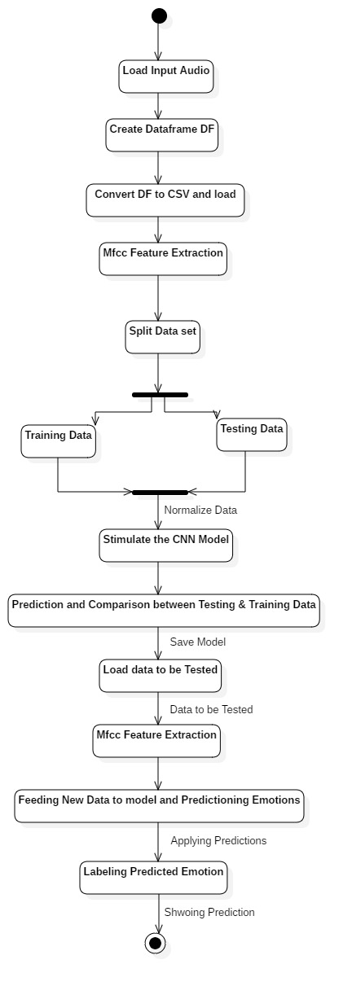
Activity Diagram

Slide 14
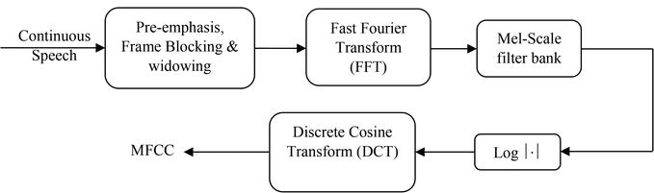
Algorithm
MFCC (Mel Frequency Cepstral Coefficients)
In the computation of MFCC, the first thing is windowing the speech signal to split the speech signal into frames. Since the high frequency formants process reduced amplitude compared to the low frequency formants, high frequencies are emphasized to obtain similar amplitude for all the formants. After windowing, Fast Fourier Transform (FFT) is applied to find the power spectrum of each frame. Subsequently, the filter bank processing is carried out on the power spectrum, using mel-scale. The Discrete cosine transform is applied to the speech signal after translating the power spectrum to log domain in order to calculate mel-frequency cepstrum coefficient.

Slide 15
CNN(Convolutional Neural Network)
A Convolutional Neural Network (ConvNet/CNN) is a Deep Learning algorithm which can take in an input image, assign importance (learnable weights and biases) to various aspects/objects in the image and be able to differentiate one from the other. The pre-processing required in a ConvNet is much lower as compared to other classification algorithms. While in primitive methods filters are hand-engineered, with enough training, ConvNets have the ability to learn these filters/characteristics.
The role of the ConvNet is to reduce the images into a form which is easier to process, without losing features which are critical for getting a good prediction
A convolution neural network has multiple hidden layers that help in extracting information from an image. The four important layers in CNN are:
Convolution Layer:
This is the first step in the process of extracting valuable features from an image. A convolution layer has several filters that perform the convolution operation. Every image is considered as a matrix of pixel values.
ReLU layer:
ReLU stands for the rectified linear unit. Once the feature maps are extracted, the next step is to move them to a ReLU layer.

Slide 16
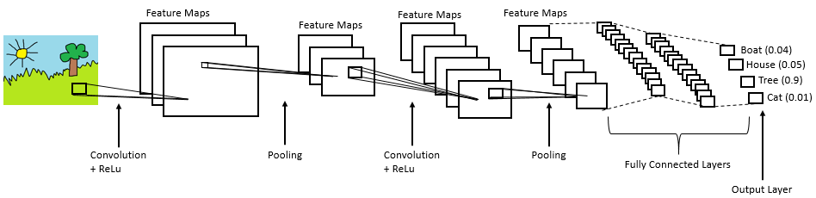
ReLU performs an element-wise operation and sets all the negative pixels to 0. It introduces non-linearity to the network, and the generated output is a rectified feature map.
Pooling Layer:
Pooling is a down-sampling operation that reduces the dimensionality of the feature map. The rectified feature map now goes through a pooling layer to generate a pooled feature map.
The next step in the process is called flattening. Flattening is used to convert all the resultant 2-Dimensional arrays from pooled feature maps into a single long continuous linear vector.
Fully Connected layer:
The flattened matrix is fed as input to the fully connected layer to classify the image.

Slide 17
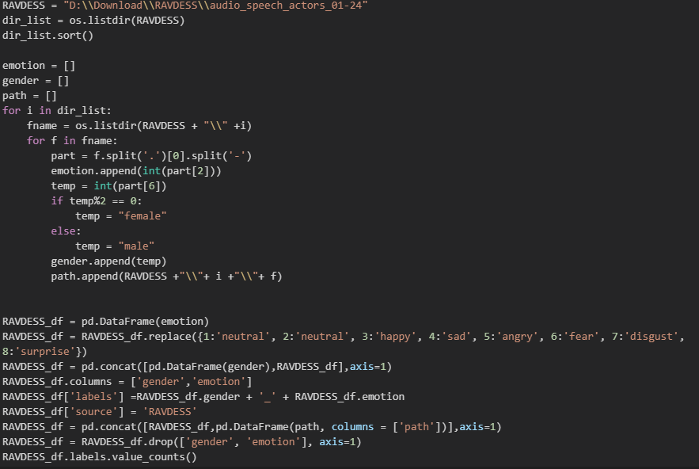
Code
1) Data Frame (Ravdess & Savee):

Slide 18
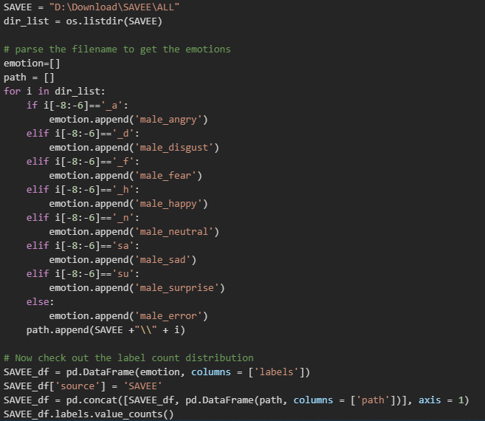

Slide 19

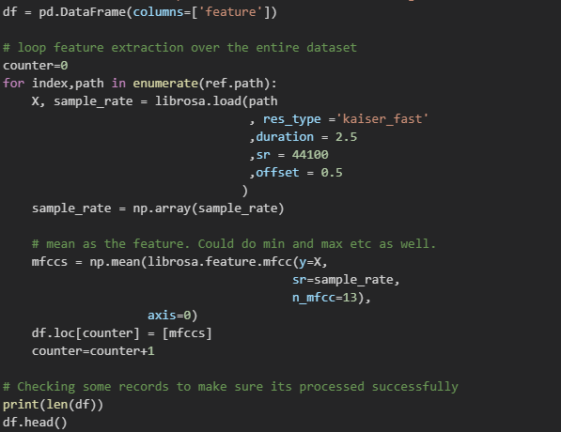
2)Data Frame Concatenate:
3)Load Data path:
4)MFCC Extraction:

Slide 20
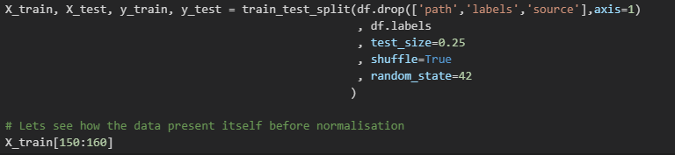
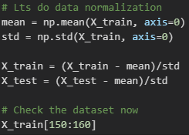
5)Split Training and Testing Data:
6)Normalization:

Slide 21
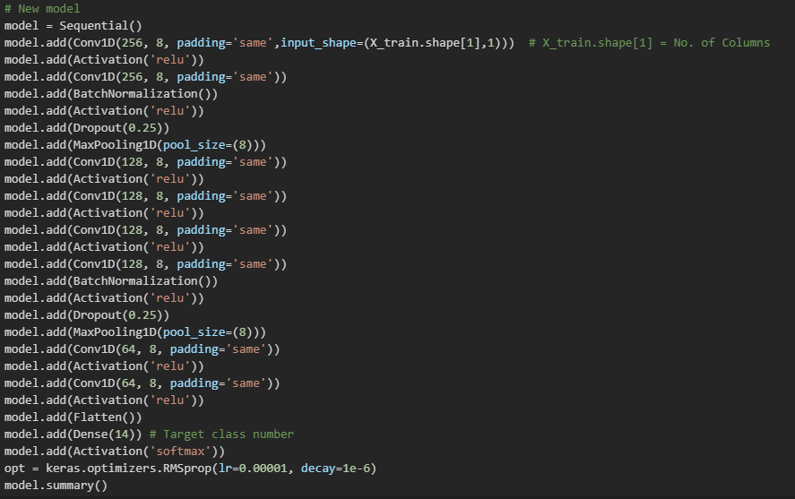
7)Model Training:

Slide 22
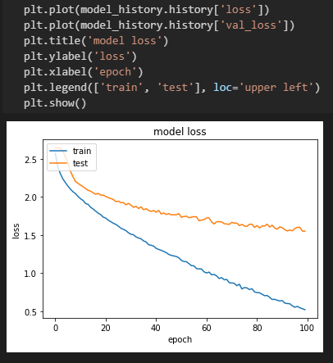
8)Compile Model:
9)Plot Model:

Slide 23
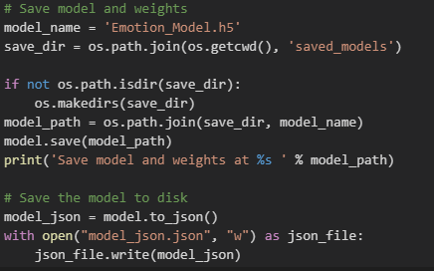
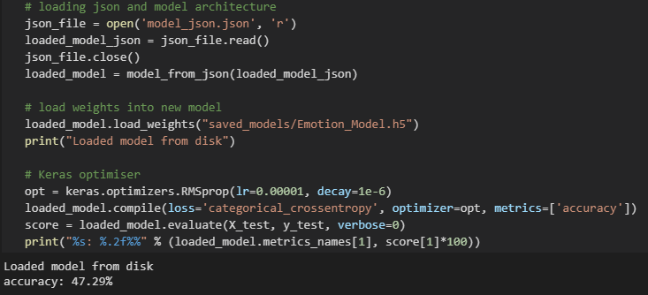
10)Save model:
11)Accuracy:

Slide 24
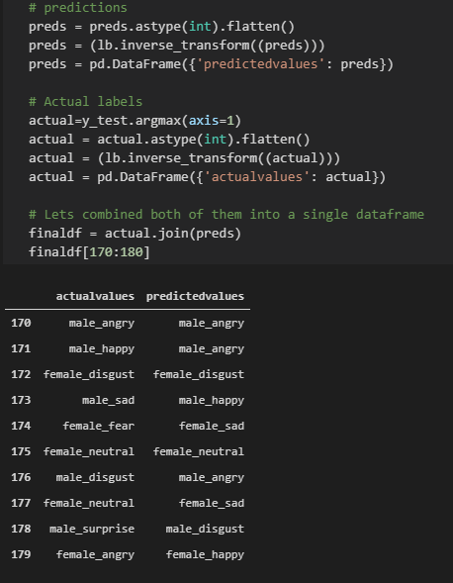
12)Prediction:

Slide 25
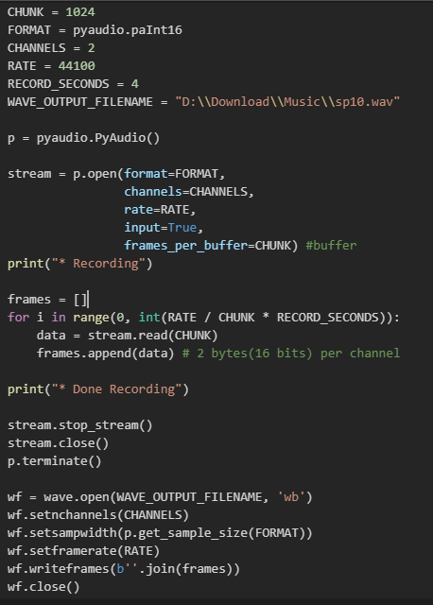
13)Recording Audio for New Data:

Slide 26
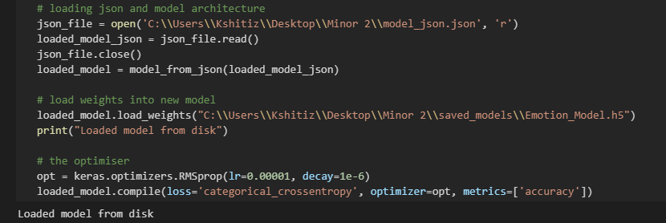
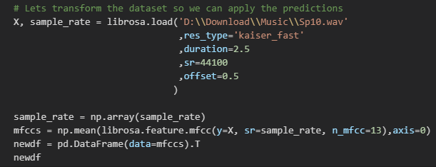
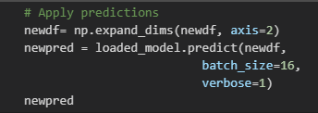
14)Model Loading:
15)MFCC New Data:
16)New Data Predictions:

Slide 27
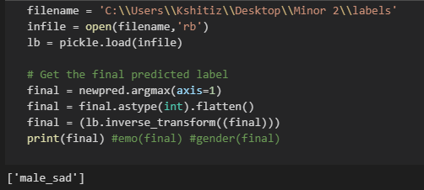
Result
17)Emotion Predicted:
Gender at 97% absolute accuracy
Emotion at 48% absolute accuracy
Gender and Emotion at 47% absolute accuracy

Slide 28
References
(PDF) MFCC-Based Feature Extraction Model for Long Time Period Emotion Speech Using CNN (researchgate.net)
Audio Classification Using CNN — An Experiment | by The Experimental Writer | AI Graduate | Medium
Some Commonly Used Speech Feature Extraction Algorithms | IntechOpen

Slide 29

THANK YOU

